Slide 1
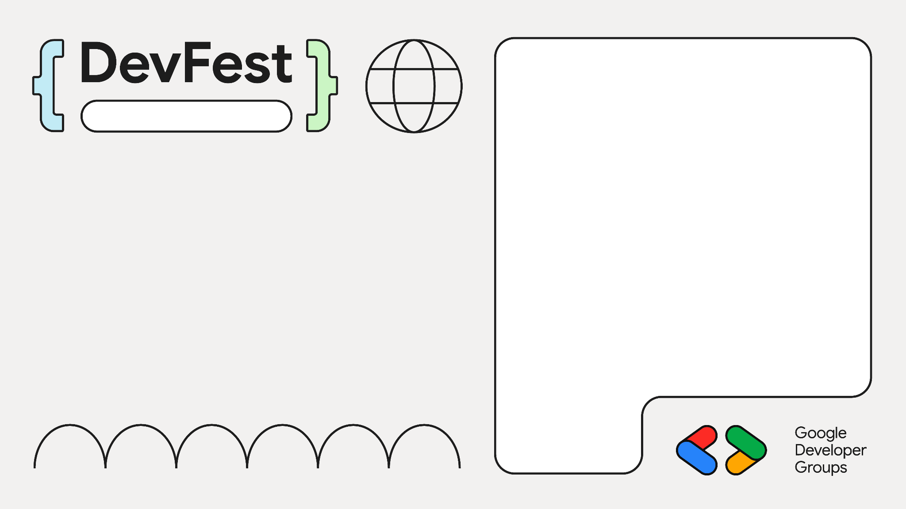

Gemini in Action: Building Smarter Applications
Addis
Dagmawi Esayas (aka Dagmawi Babi)

Slide 2
Gemini in Action: Building Smarter Applications
Addis
Dagmawi Esayas (aka Dagmawi Babi)

Slide 3
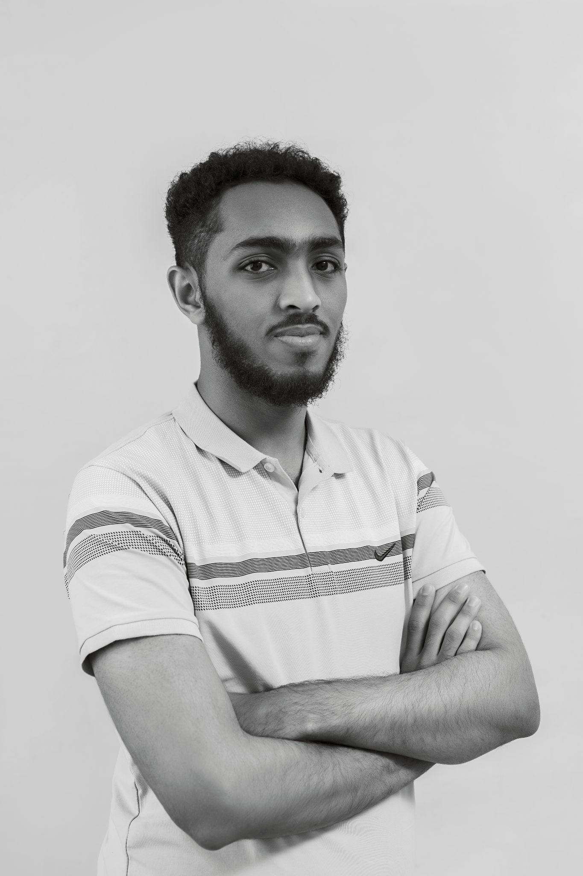
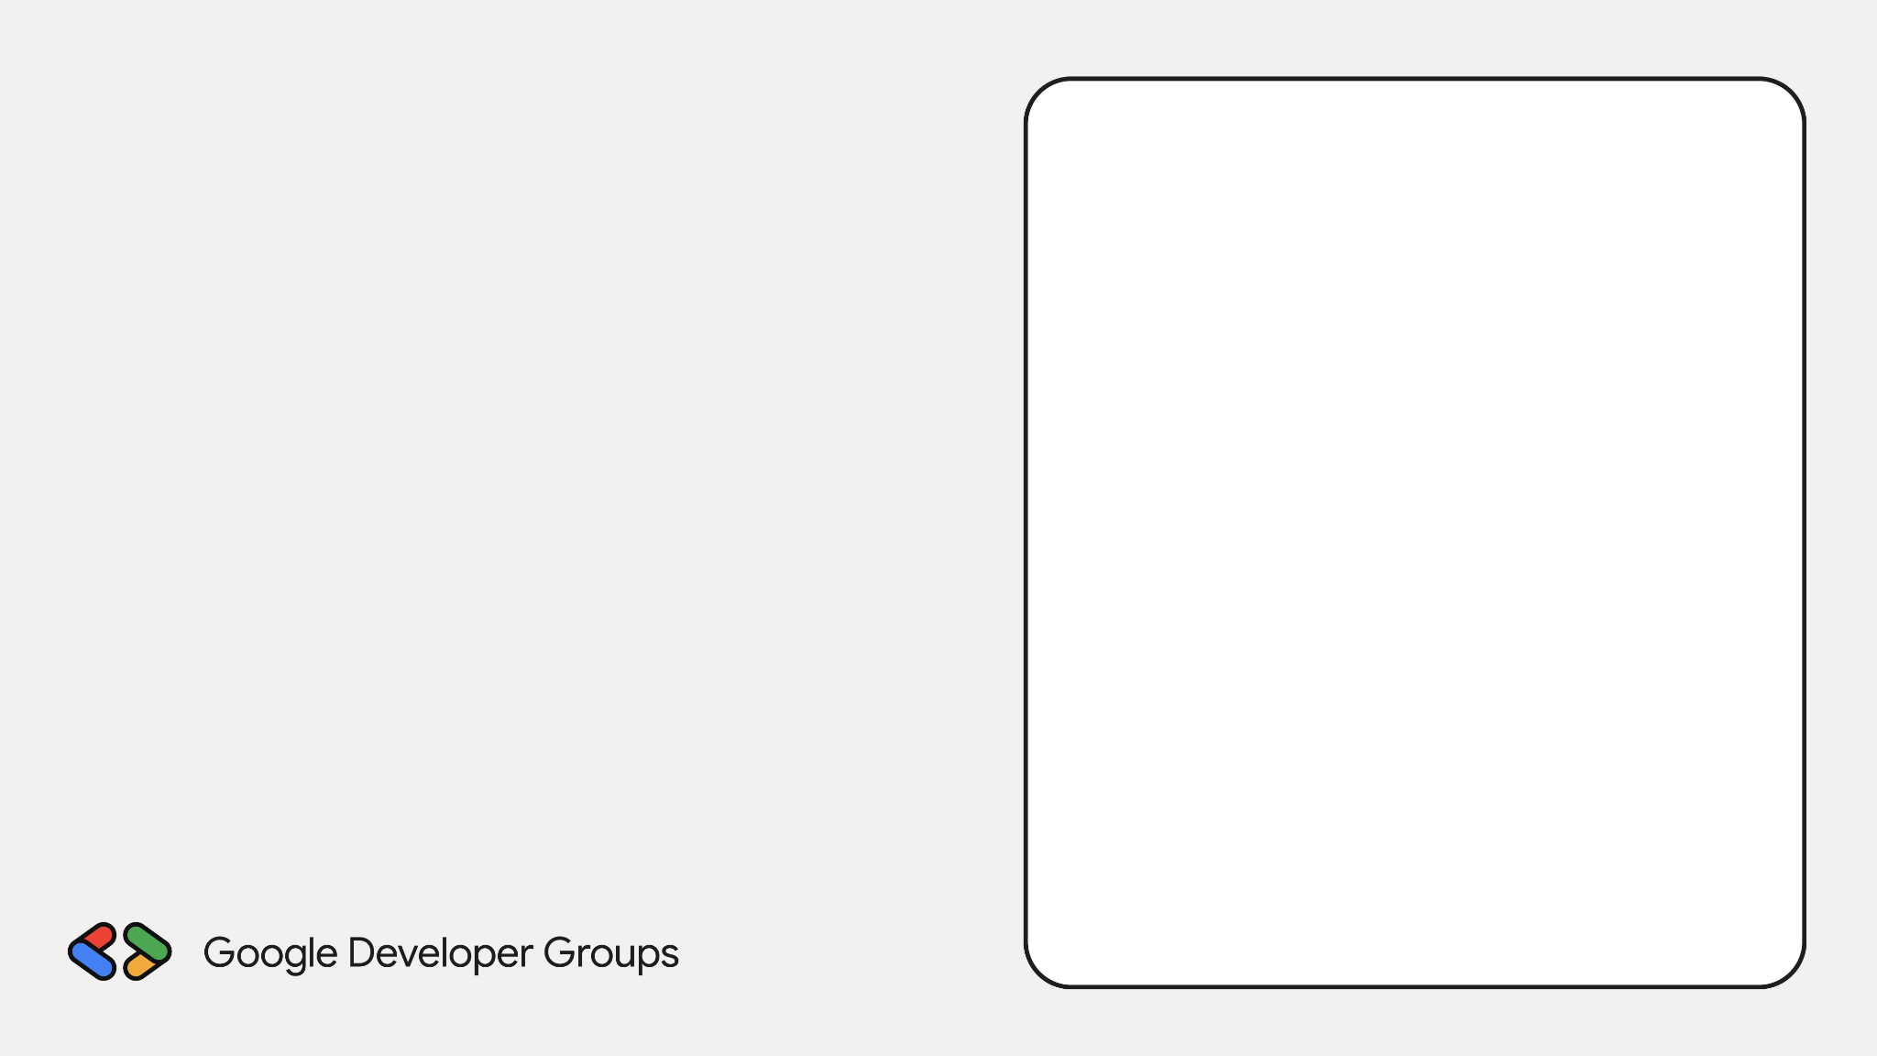
Who is this guy?

Slide 4
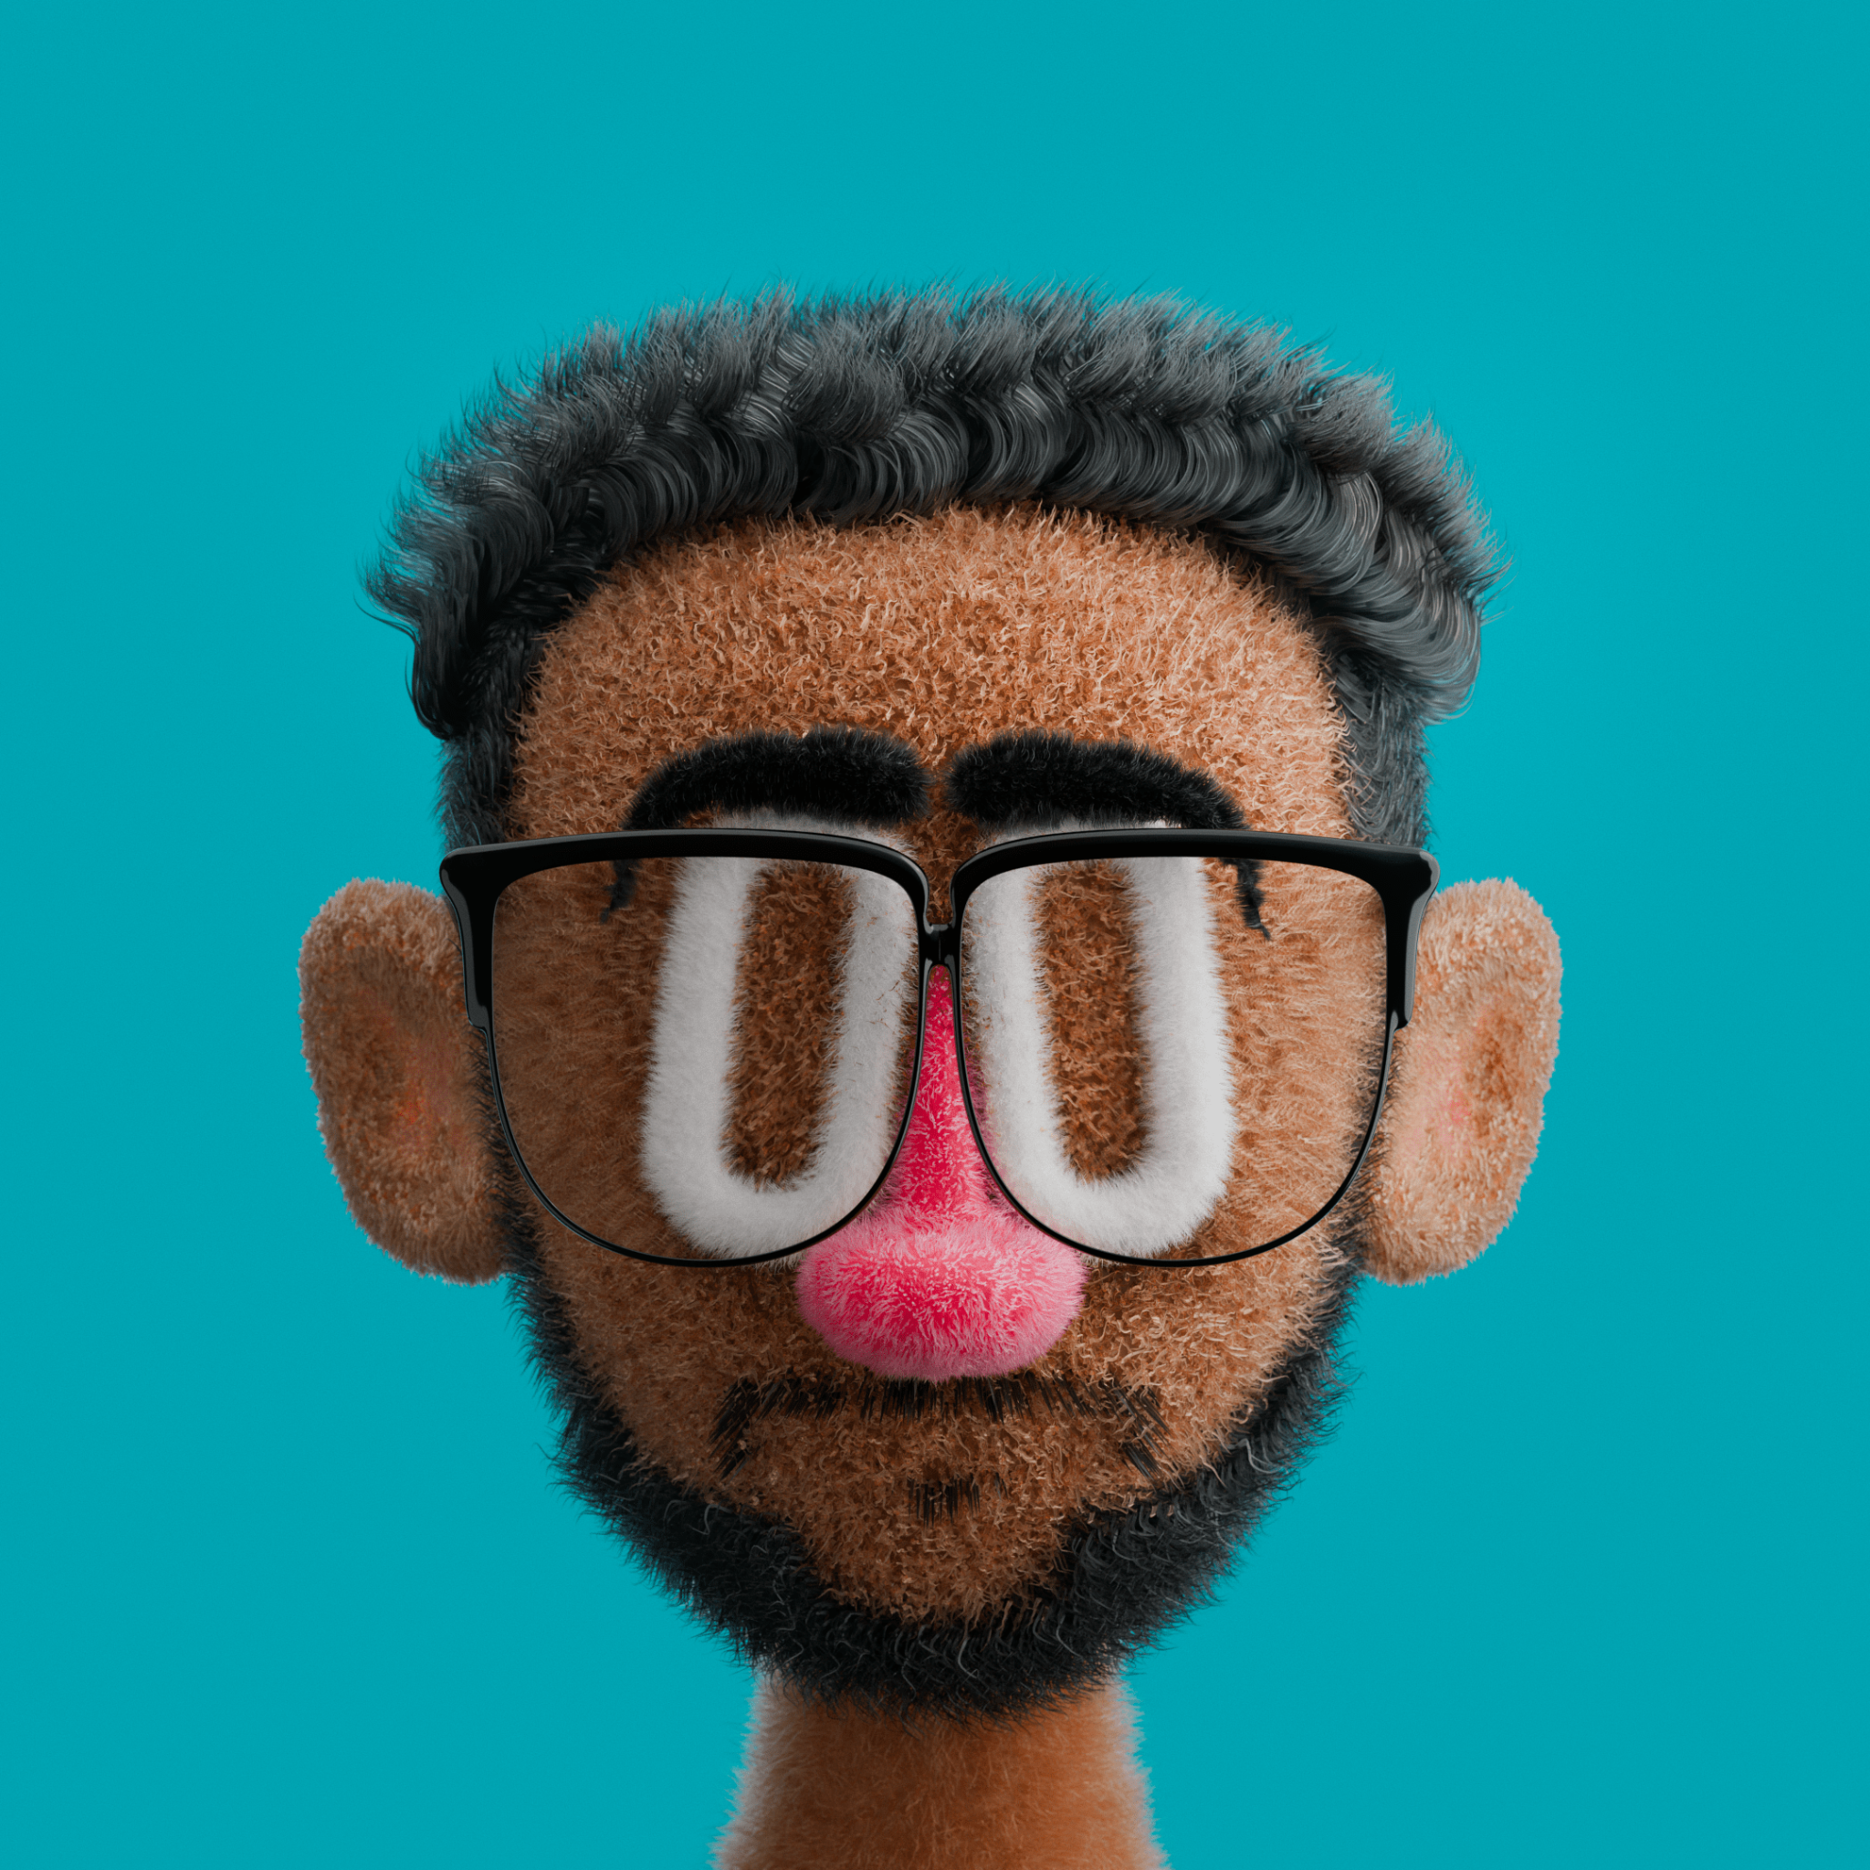
Full Stack Dev
Content Creator
Creative Developer
Podcast Host
Freelancer
also a weirdo at times

Slide 5
Why should I listen to him?

Slide 6

I built …
ScholArxiv
“One of the best, open source, beautiful, absolutely perfect, just mind blowing research paper exploring apps out there.”
– someone probably said this

Slide 7
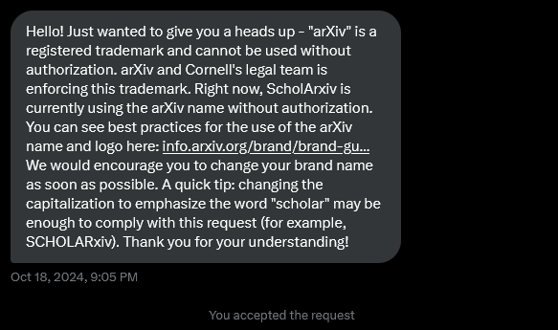
I built …
ScholArxiv
And
Almost got sued!

Slide 8
So much eyebrow 🤔

Slide 9
Gemini in Action: Building Smarter Applications
Addis
Dagmawi Esayas (aka Dagmawi Babi)

Slide 10
Gemini in Action: Building Smarter Applications
Addis
Dagmawi Esayas (aka Dagmawi Babi)

Slide 11
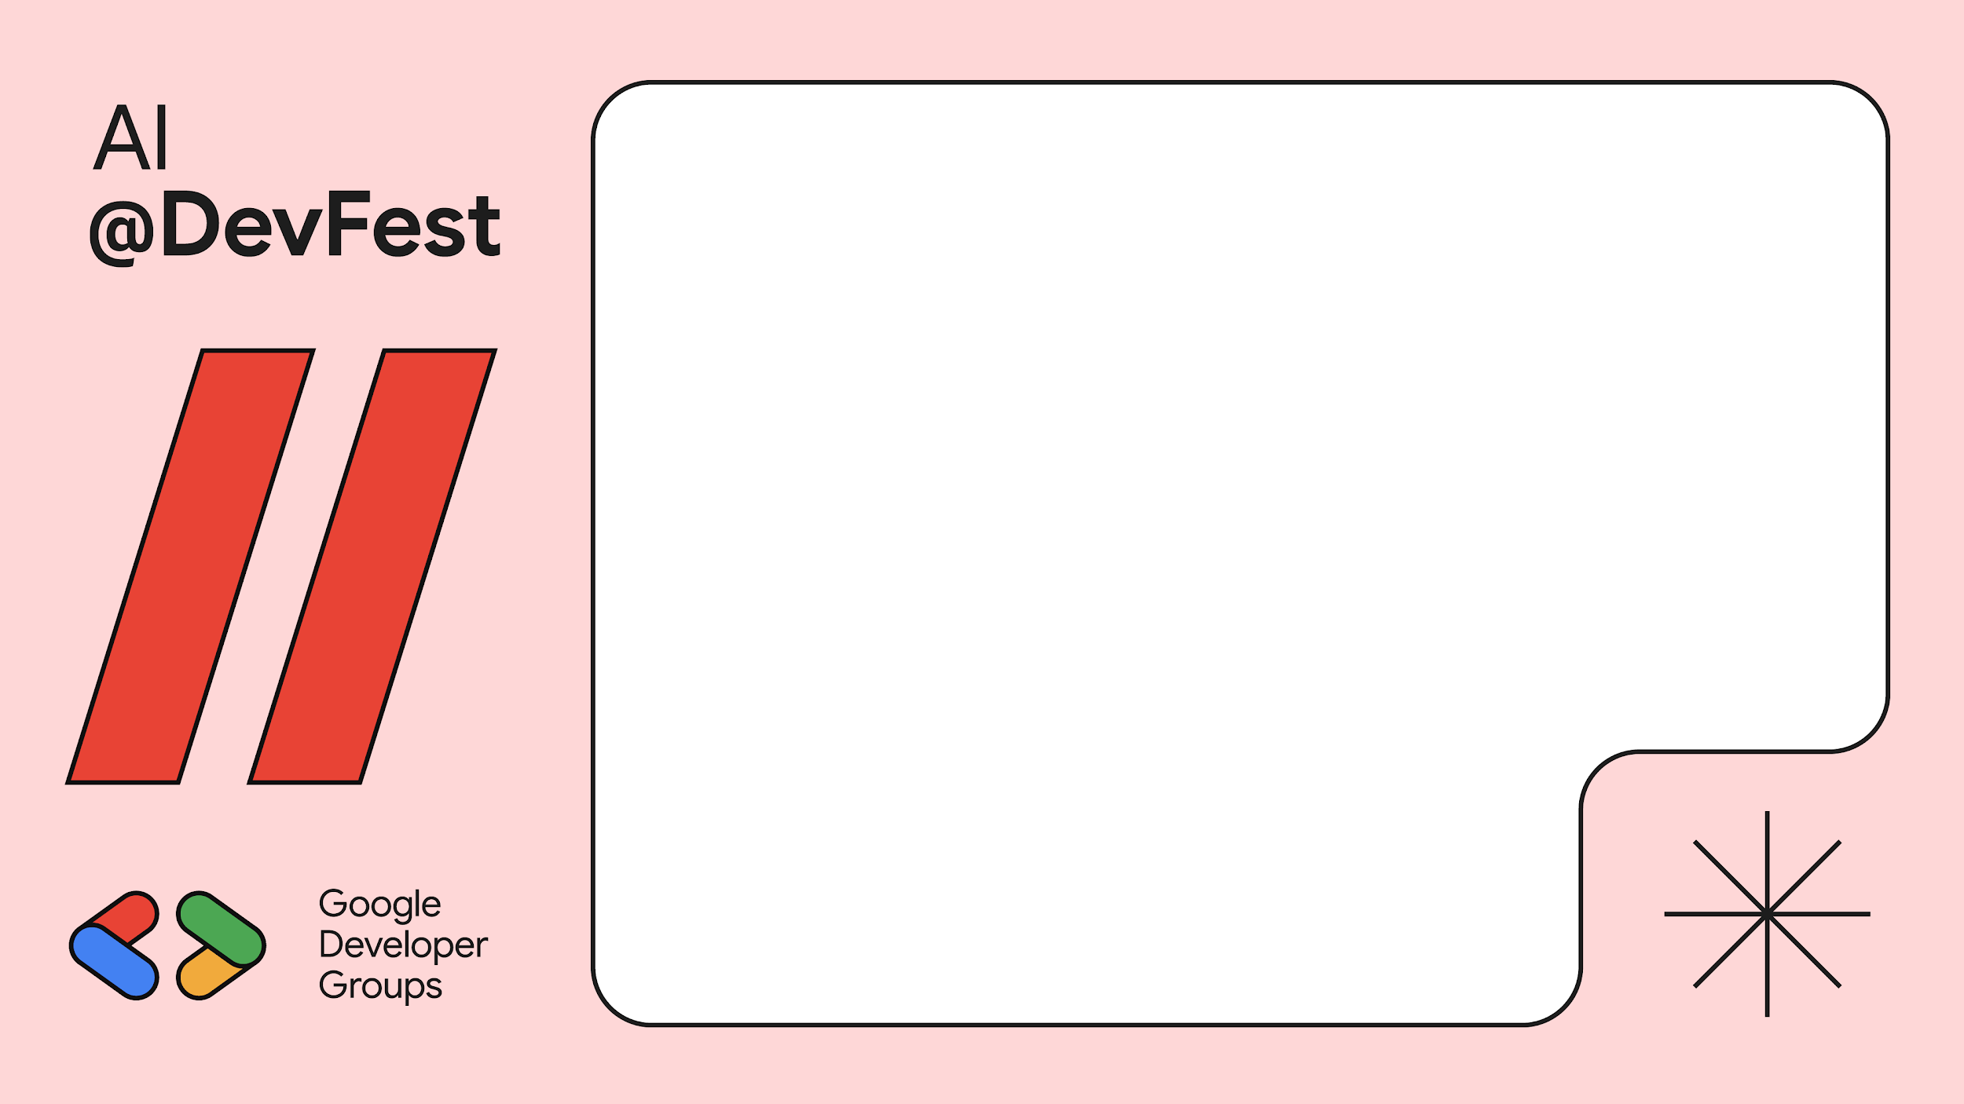
How to integrate an LLM into your apps
GEMINI – GROK – GPT-4o
Sonnet – LLaMA – Abebech

Slide 12
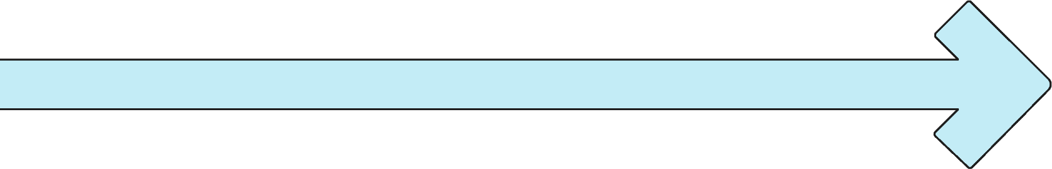
How to integrate an AI API into your apps?
Get an
API Key
1
Understand the limits

Slide 13
How to integrate an AI API into your apps?
Use OpenAPI Package
2
Understand it’s parameters

Slide 14
How to integrate an AI API into your apps?
Integrate with your data
3
System Prompts and Context

Slide 15
How to integrate an AI API into your apps?
Get an
API Key
Use OpenAPI Package
Integrate with your data
1
2
3
Understand the limits
Understand it’s parameters
System Prompts and Context

Slide 16

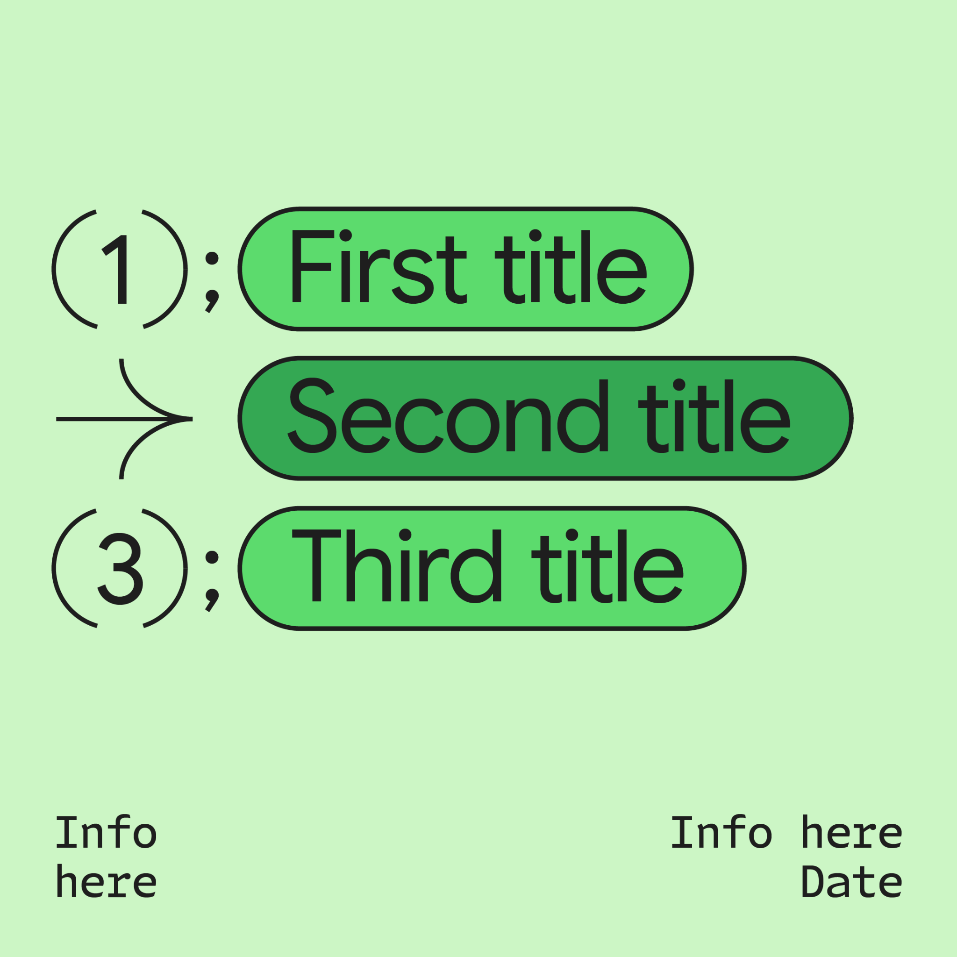

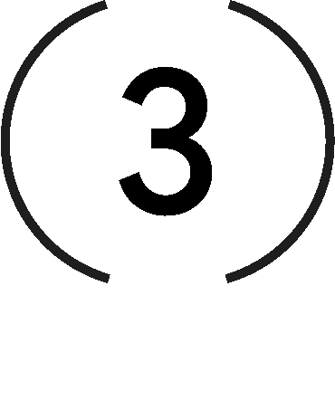
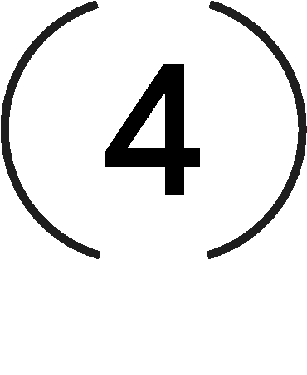

Steps
Visit Google’s AI Studio (ai.google.dev)

Slide 17
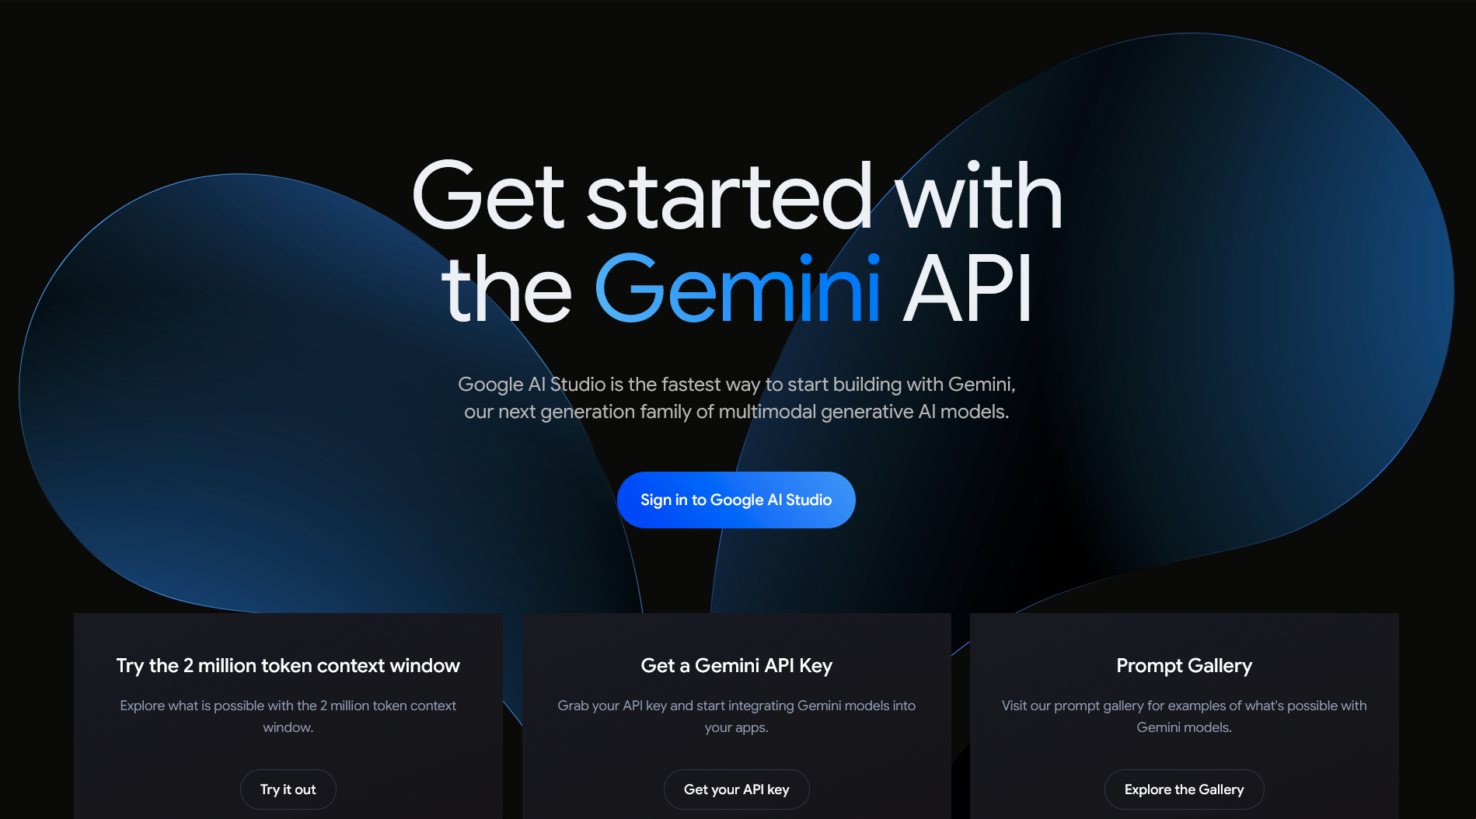
Who is this guy?

Slide 18
Steps
Visit Google’s AI Studio (ai.google.dev)
Get your API key

Slide 19
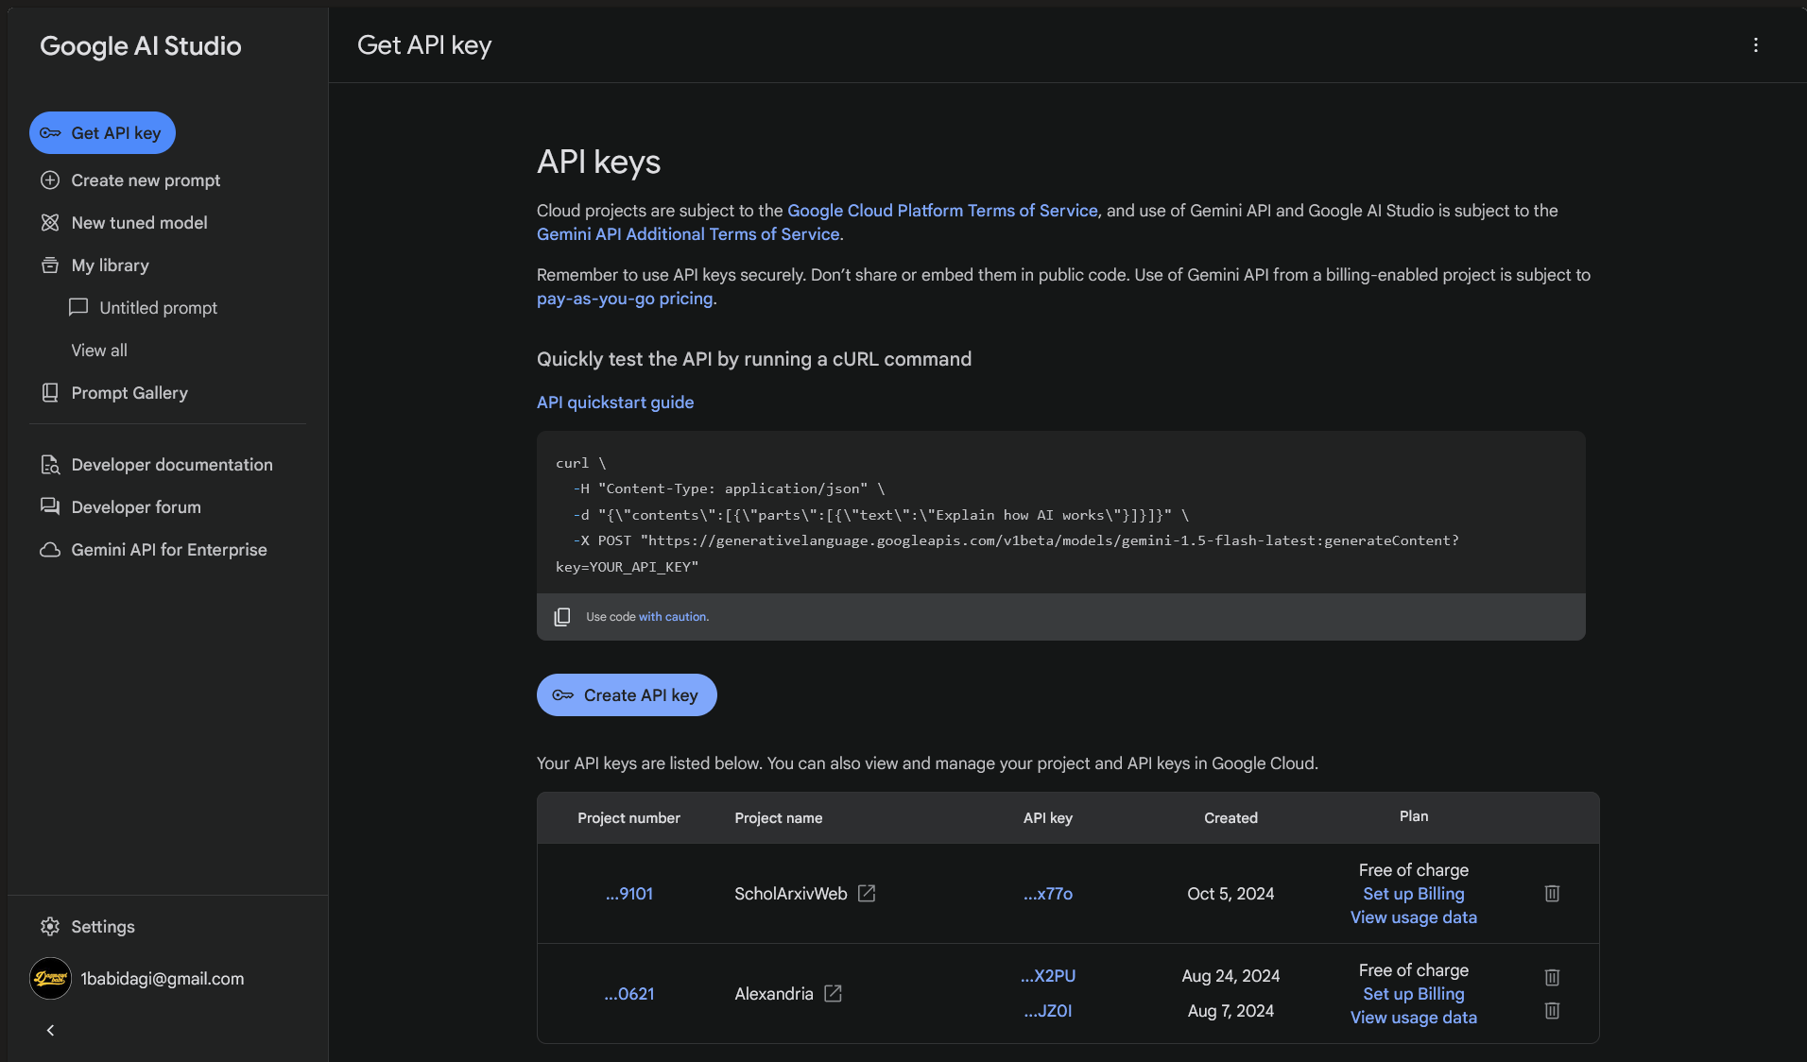
Who is this guy?

Slide 20
Steps
Visit Google’s AI Studio (ai.google.dev)
Get your API key
Install OpenAI Package

Slide 21
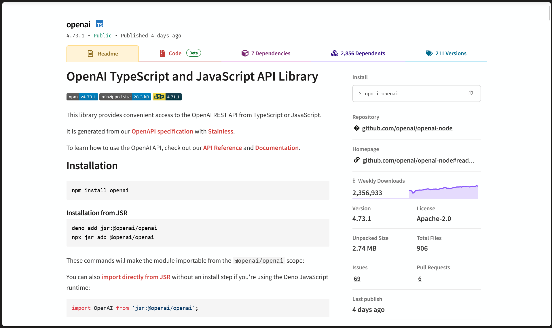
Who is this guy?

Slide 22
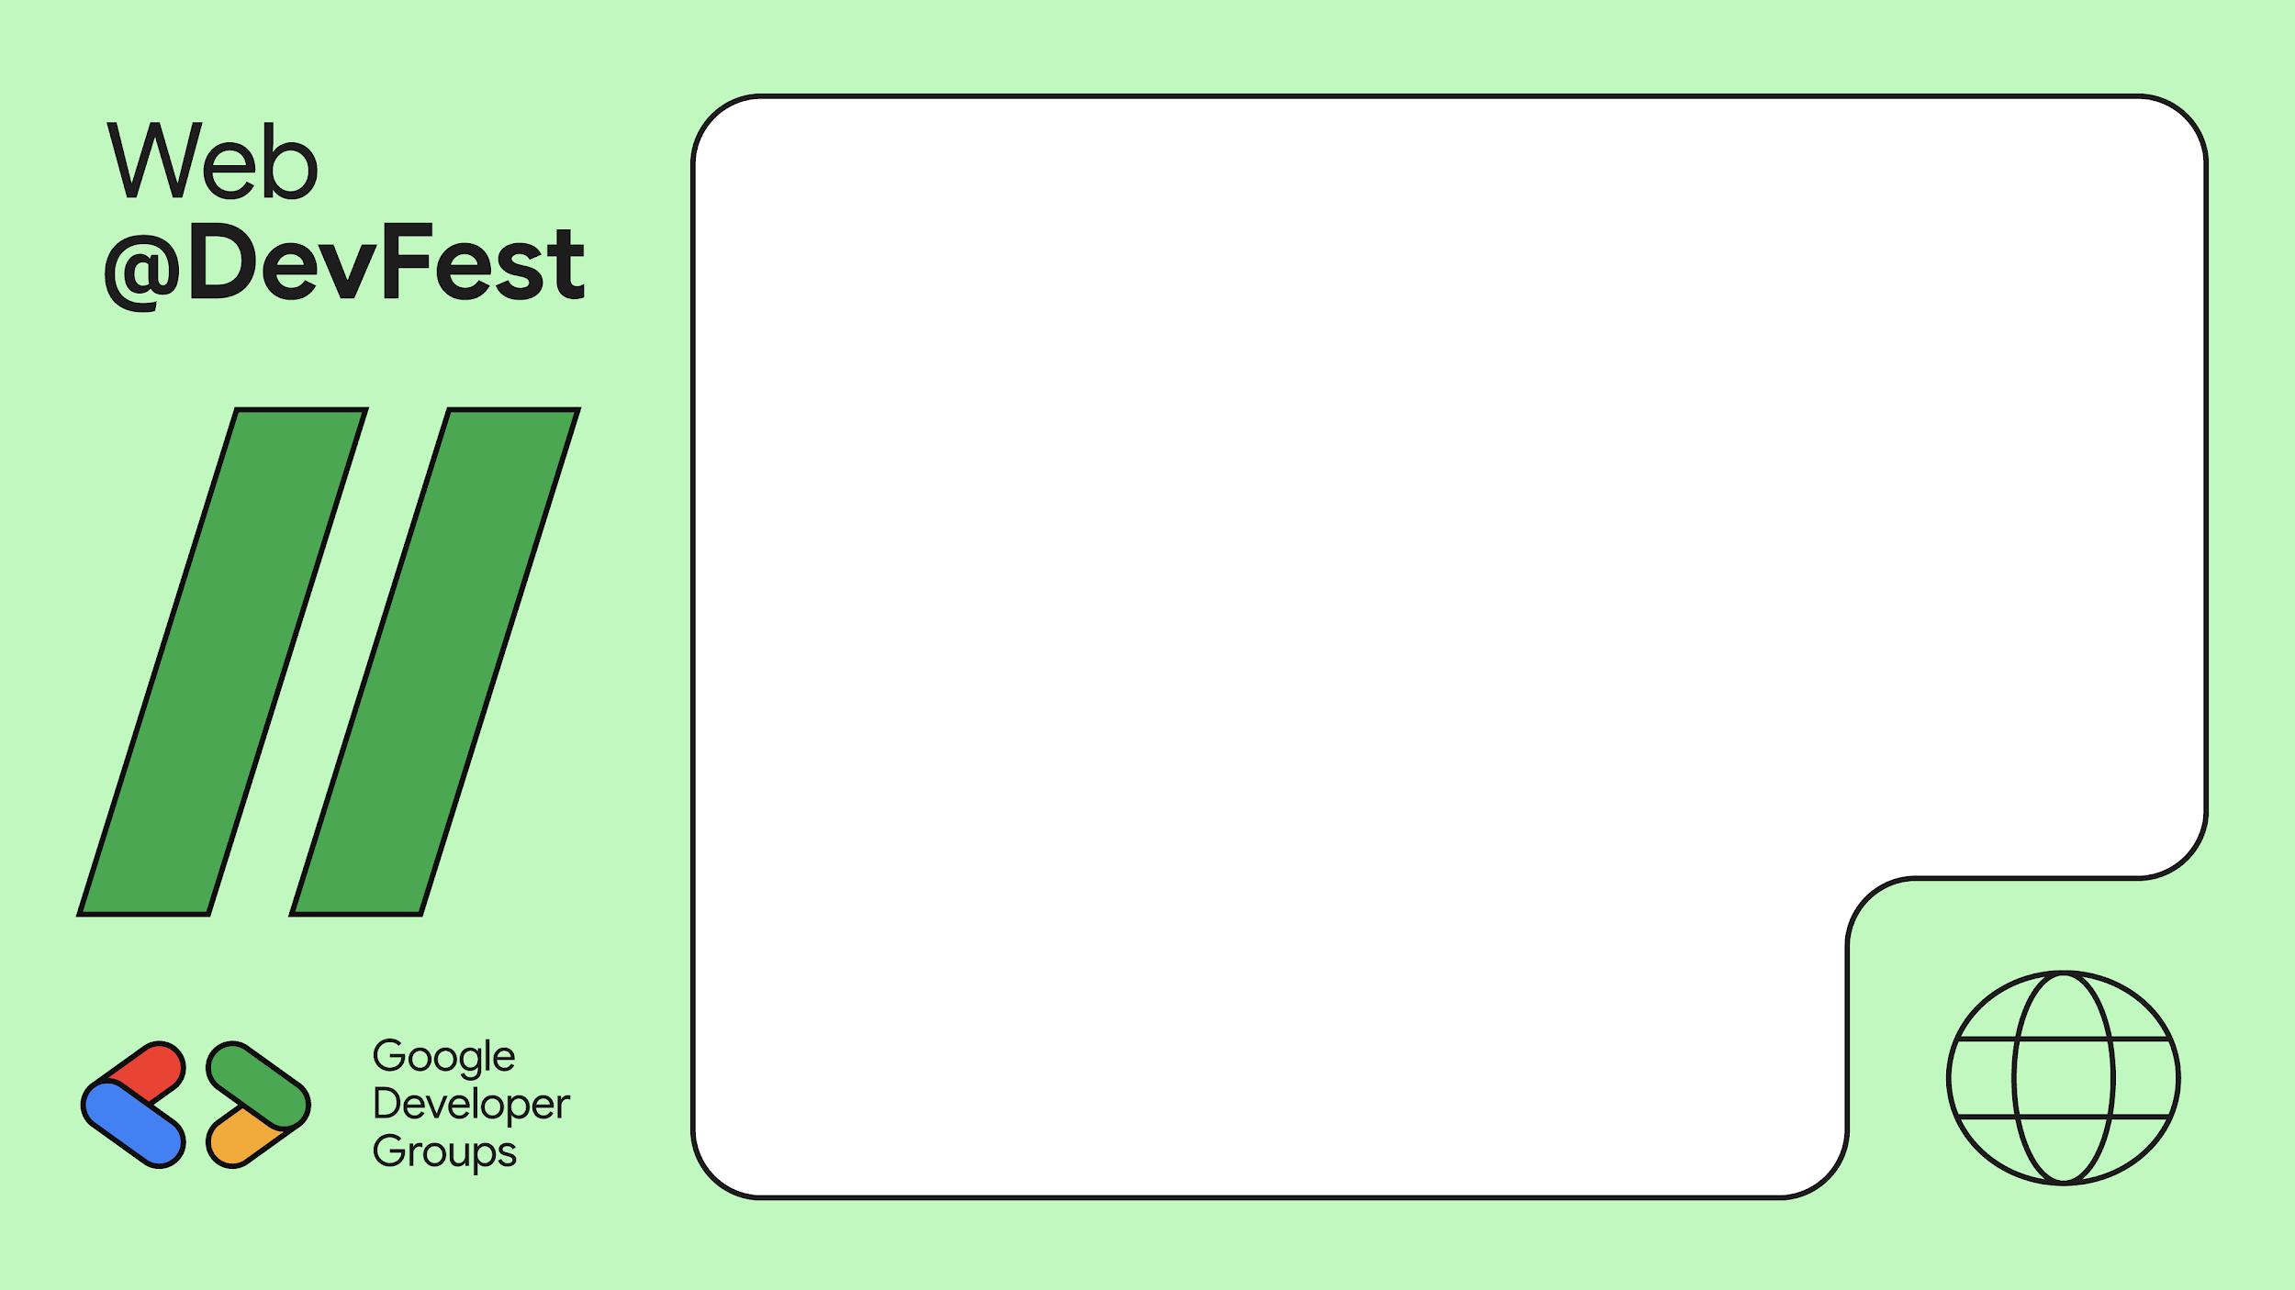
npm i openai

Slide 23
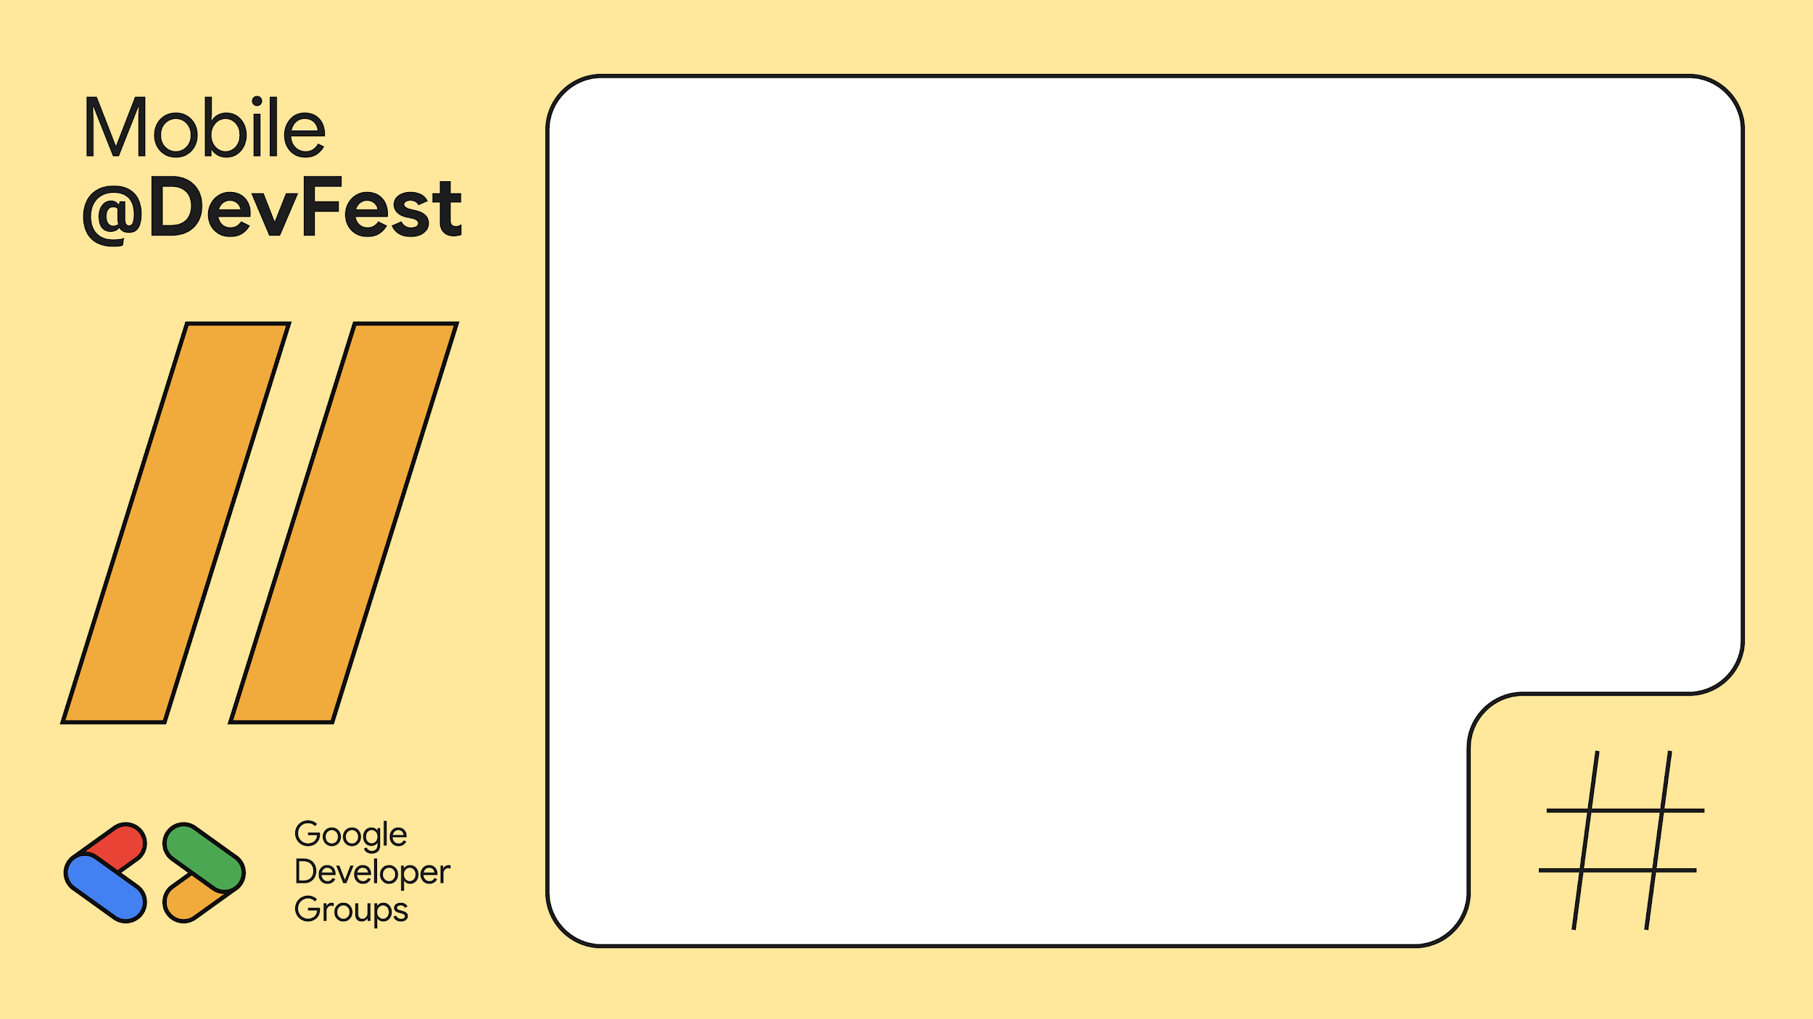
dart pub add openai

Slide 24
Steps
Visit Google’s AI Studio (ai.google.dev)
Get your API key
Install OpenAI Package
Understand Limits and Parameters

Slide 25
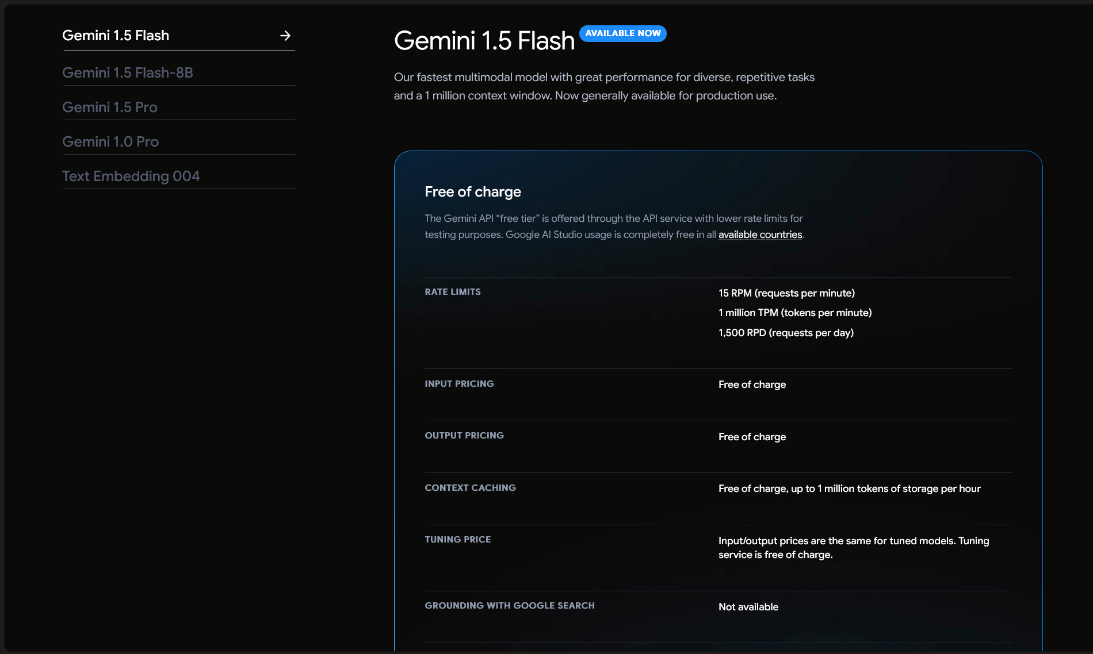
Who is this guy?

Slide 26
Steps
Visit Google’s AI Studio (ai.google.dev)
Get your API key
Install OpenAI Package
Understand Limits and Parameters
Dagm is so cool

Slide 27
Demo time :)

Slide 28
What is the world doing with LLMs right now?
Rabbit R1

Slide 29
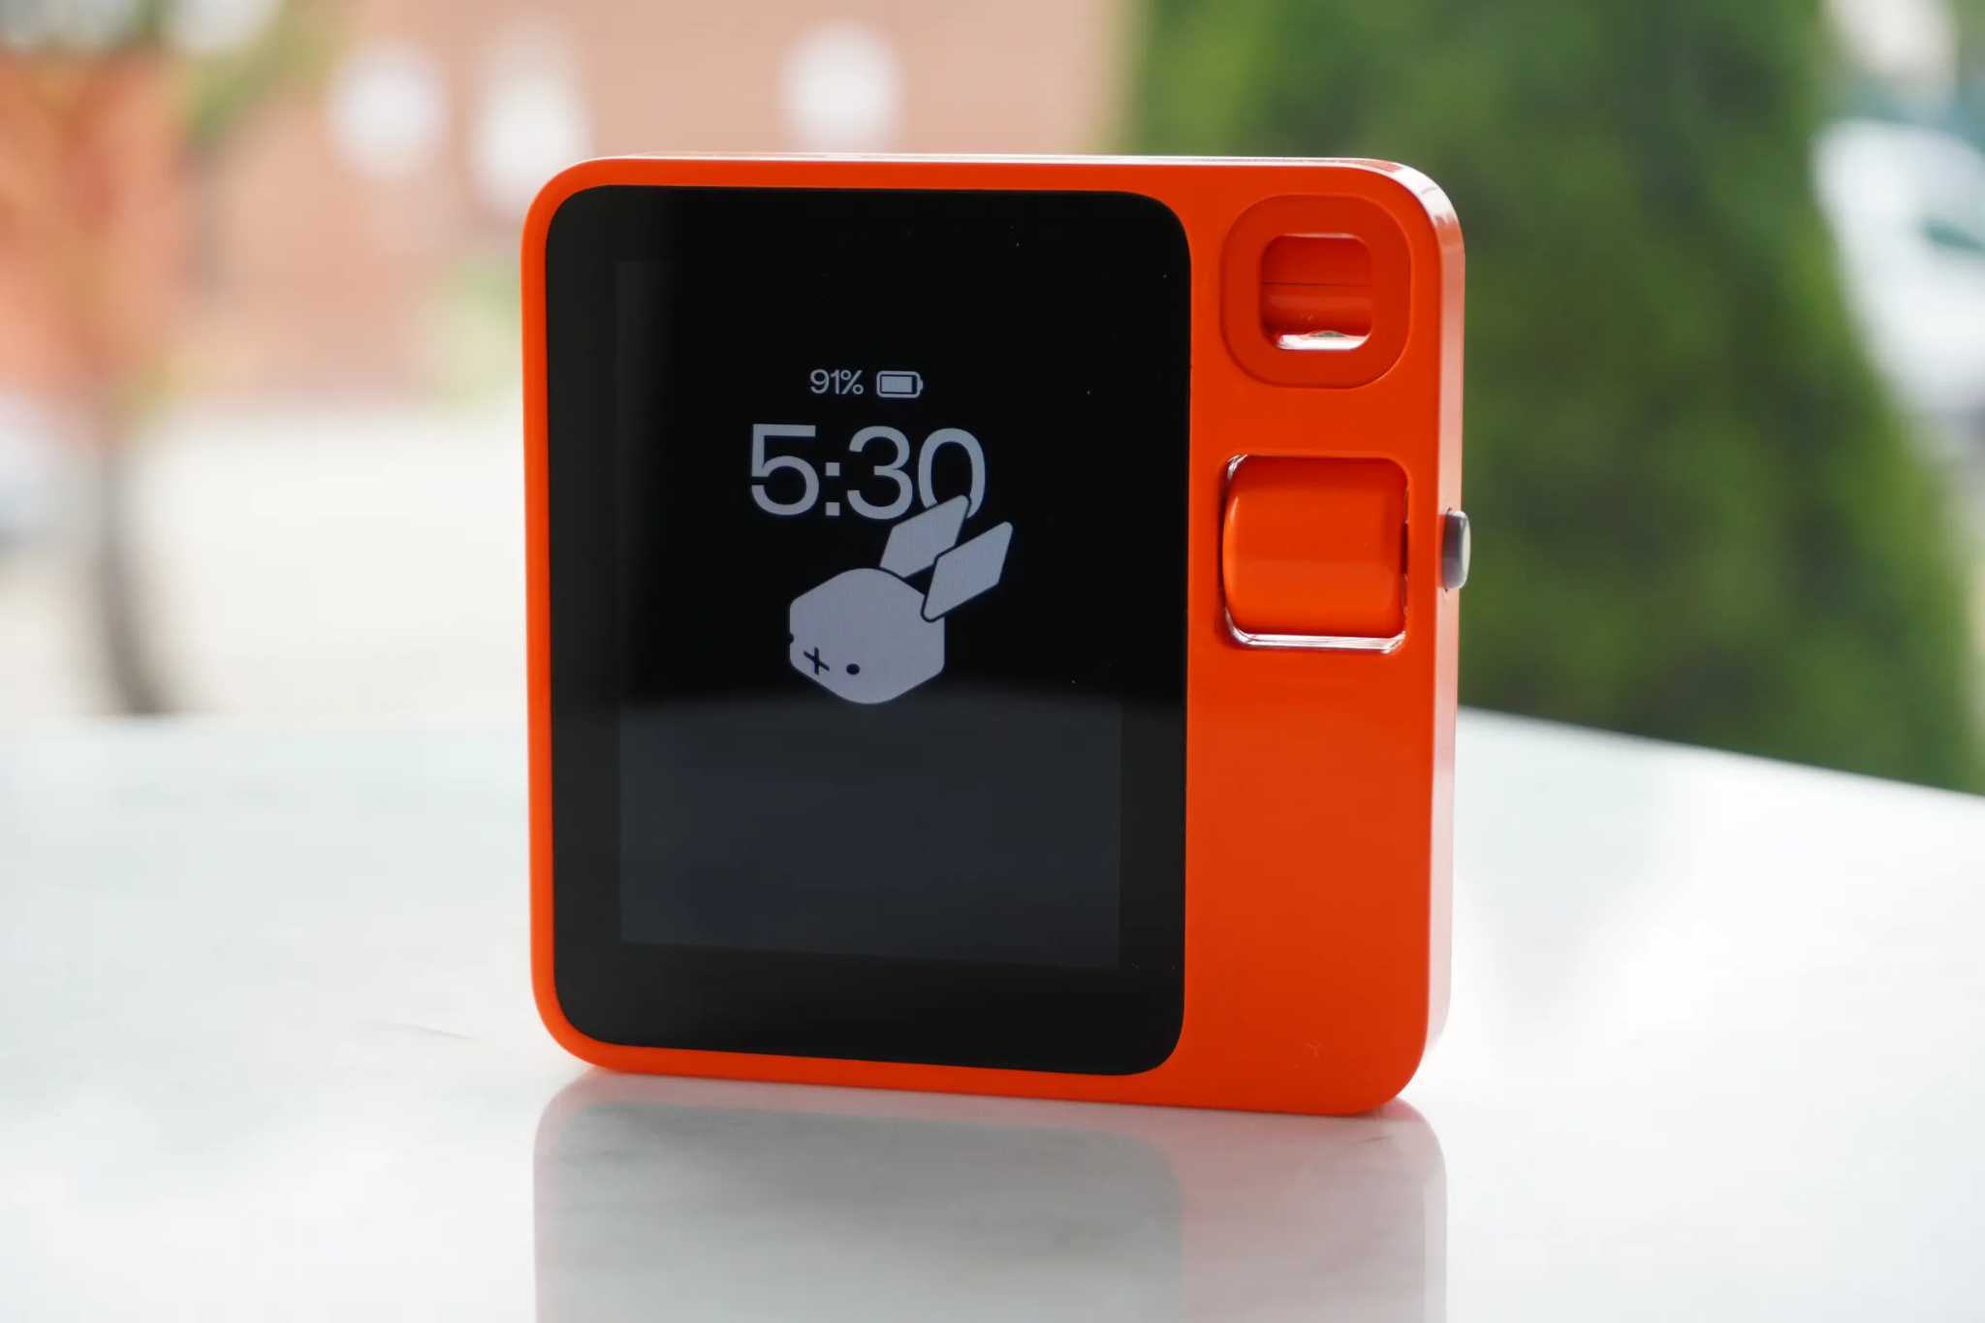
The Rabbit R1 Dream

Slide 30
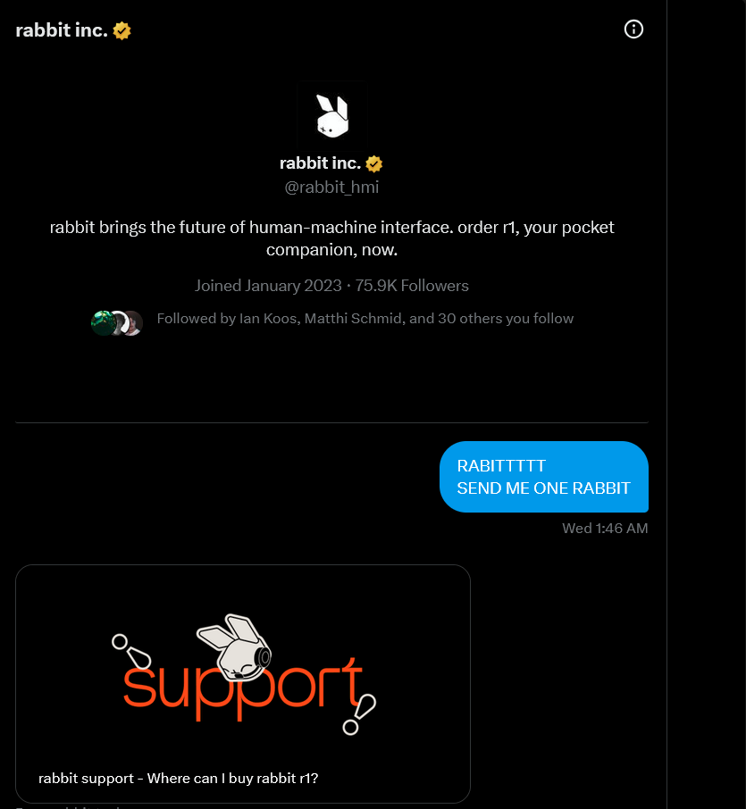
Just in time for this talk
I asked them to send me
one Rabbit R1

Slide 31
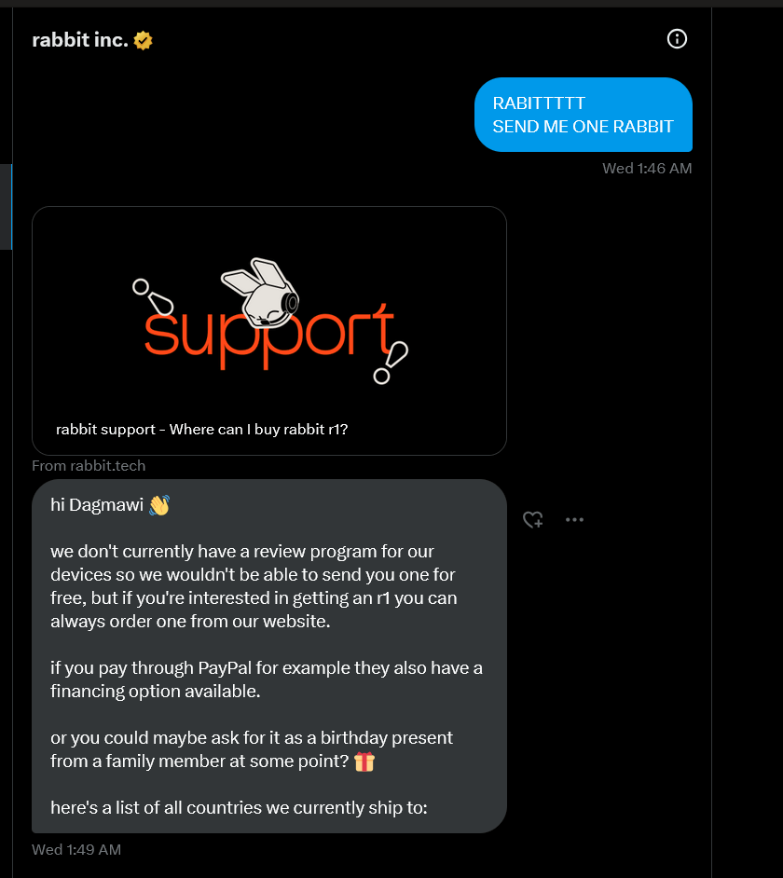
They said no :(
Sorry.

Slide 32
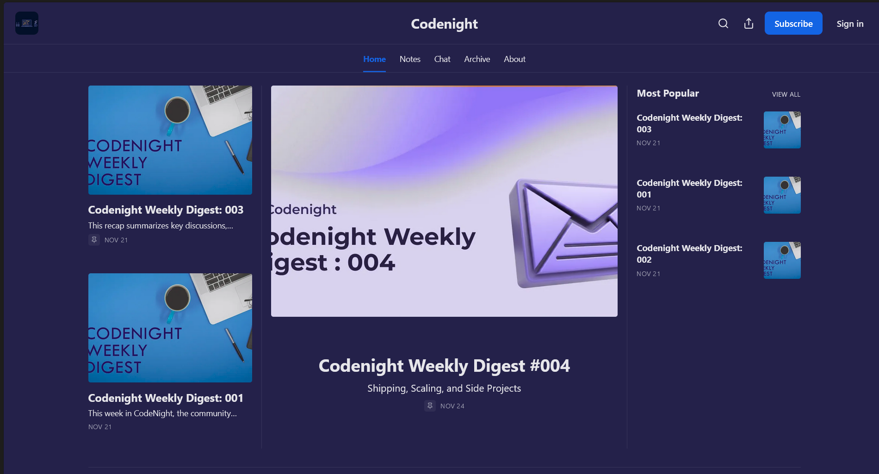
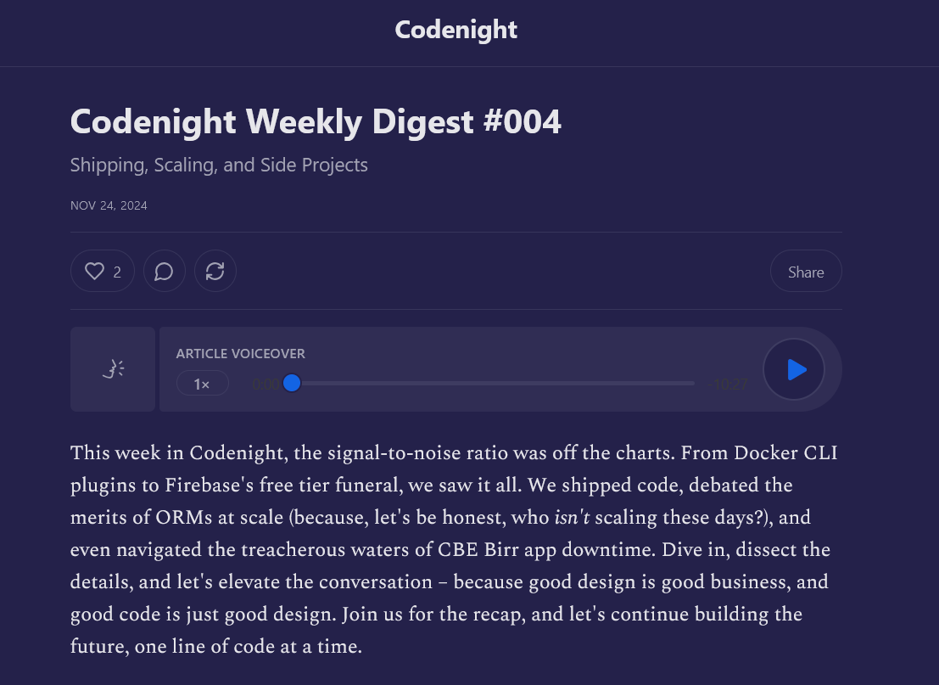
The Rabbit R1 Dream

Slide 33
Finally…
Addis

Slide 34
Remember how I built
ScholArxiv
And
Almost got sued!

Slide 35
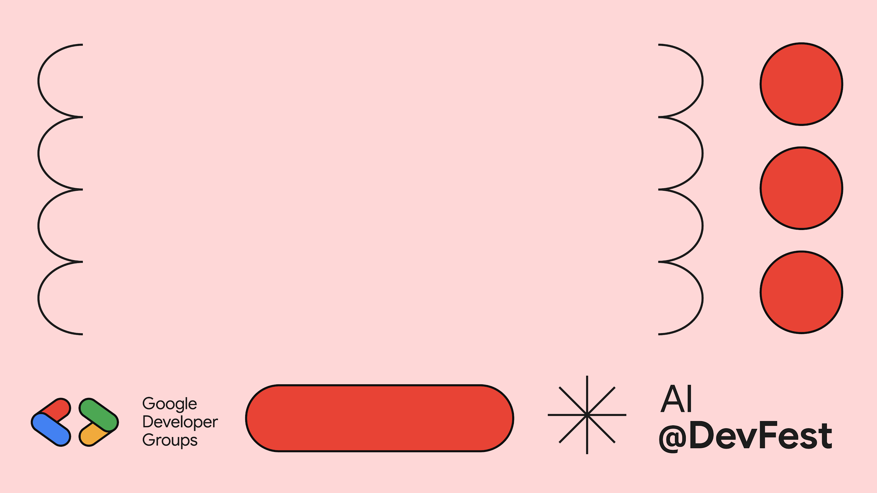
Sneak Peak :)

Slide 36
Thank You So Much!
You’ve been so lovely.
Addis

